Slide 1
Improving the Health and Well-Being of People with Disabilities, Plus Older Adults and Veterans too! May 2018
Adriane K. Griffen, DrPH, MPH, MCHES Senior Director of Public Health and Leadership Association of University Centers on Disabilities (AUCD)
Tweet
What’s Happening NOW!
#Health4All
@adrianegriffen @AUCDNews
www.aucd.org
Notes:
Adriane’s Contact (202) 210-1546.

Slide 2
Agenda: National Perspective National Tools for Disability Inclusion in Public Health AUCD Tools Including People with Disabilities: Public Health Workforce Competencies Public Health is for Everyone Partner with AUCD Network-Online Directory Call to Action: Hats You Wear, Resilience & Self-Care
Notes:
Inform and inspire

Slide 3
The secret of change is to focus all your energy not on fighting the old, but on building the new. Socrates

Slide 4
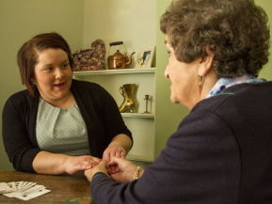
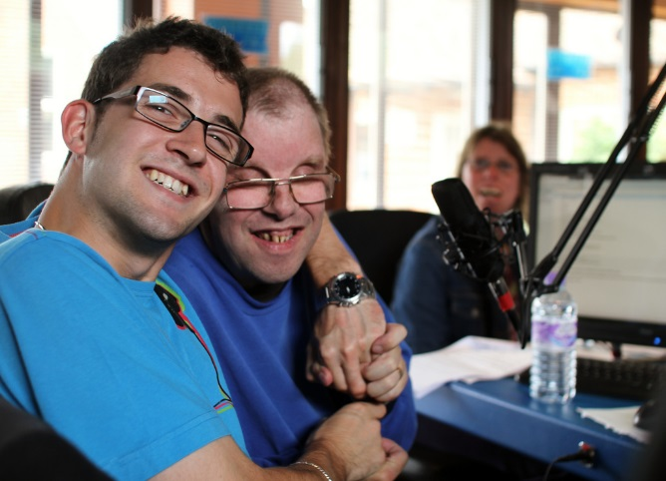
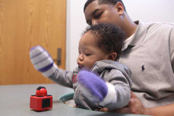
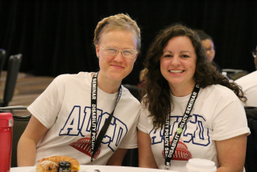
AUCD Mission
AUCD's mission is to advance policies and practices that improve the health, education, social, and economic well-being of all people with developmental and other disabilities, their families, and their communities by supporting our members in research, education, health, and service activities that achieve our vision.

Slide 5
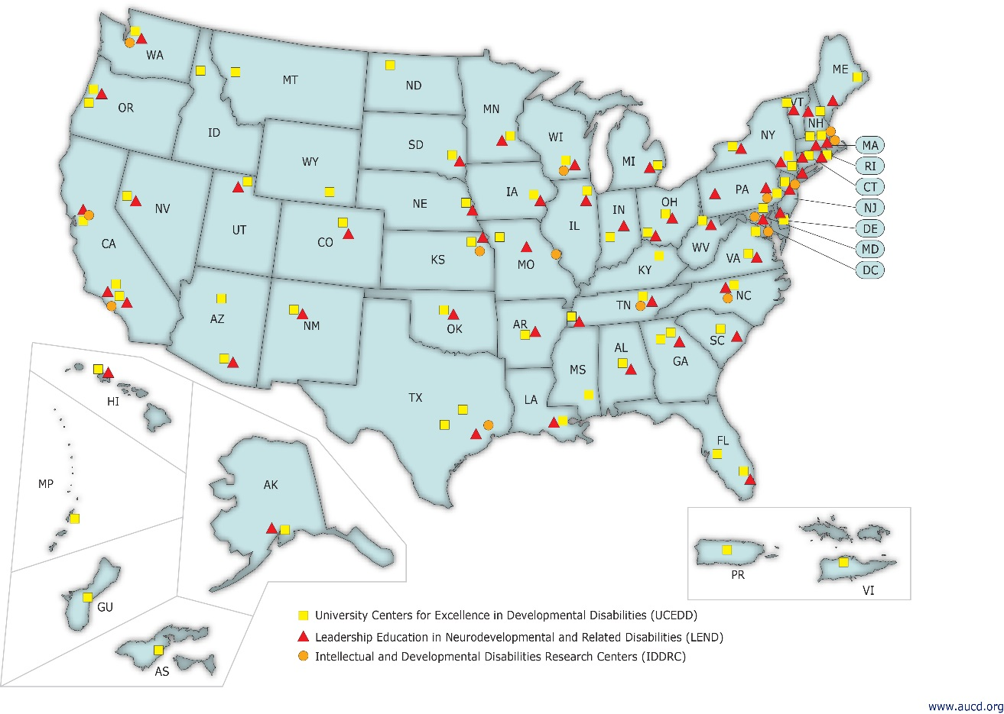
AUCD is a National Network
Network members consist of:
67 University Centers for Excellence in Developmental Disabilities (UCEDDs)
52 Leadership Education in Neurodevelopmental and Related Disabilities (LEND) Programs
14 Intellectual and Developmental Disabilities Research Centers (IDDRCs)

Slide 6
AUCD Strategic Map: Updates
Notes:
AG

Slide 7
AUCD Network
Notes:
AUCD is a connector – 130 centers, leadership training, university centers, research centers

Slide 8
National Perspective People living with disabilities have higher risk for poor health outcomes hypertension, obesity, falls-related injuries, diabetes, smoking, depression. Most public health training programs do not include curriculum on people with disabilities and methods for including them in core public health efforts.

Slide 9
National Tools
http://dhds.cdc.gov/
www.cdc.gov/sixeighteen

Slide 10
Texas Health Topics by Disability Status
State Profile
Health Risks & Behaviors
Table 1. Health risks and behaviors by disability status³
Indicator (year) | Any Disability | Cognitive Disability | Mobility Disability | Vision Disability | No Disability
Binge drank in the past 30 days (2014) | 16.6% | 20.6% | 10.5% | 12.3% | 16.5%
Obese based on body mass index (2014) | 42.7% | 39.4% | 52.6% | 40.6% | 28.2%
Sufficient aerobic physical activity (2013) | 31.8% | 30.8% | 26.7% | 30.2% | 45.7%
Meets both aerobic and muscle strengthening physical activity guidelines (2013) | 11.9% | 11.5% | 12.6% | 10.0% | 19.7%
Currently smoke cigarettes (2014) | 24.3% | 29.1% | 25.0% | 25.2% | 12.4%
Smokers who attempted to quit in the past 12 months (2014) | 60.9% | 61.7% | 58.9% | 60.6% | 54.9%
Tested for HIV (age 18-64) (2014) | 46.9% | 50.7% | 46.1% | 40.3% | 39.9%
https://dhds.cdc.gov/

Slide 11
Including People with Disabilities: Public Health Workforce Competencies www.disabilityinpublichealth.org
AUCD Tools:
Notes:
Work smarter

Slide 12
Competency 1: Discuss disability models across the lifespan Competency 2: Discuss methods used to assess health issues for people with disabilities Competency 3: Identify how public health programs impact health outcomes for people with disabilities Competency 4: Implement and evaluate strategies to include people with disabilities in public health programs that promote health, prevent disease, and manage chronic and other health conditions www.disabilityinpublichealth.org
Notes:
Work smarter - Call to Action:
Include people with disabilities in public health program planning and design
How:
Identify a program, health promotion event, or community need
Creative partnerships
Talking with people with disabilities and caregivers
Competencies resource for examples
Free learning modules

Slide 13
Public Health is for Everyone: An inclusive planning toolkit for public health professionals
www.phetoolkit.org
Notes:
Public health professionals can search and browse disability and health related resources by their community and professional needs
Practitioners can use the field guides, factsheets, checklists, brochures, and additional tools to create programs that meet the needs of people with disabilities
Resources showcase how public health programs have been designed or modified to fit the needs of people with disabilities

Slide 14
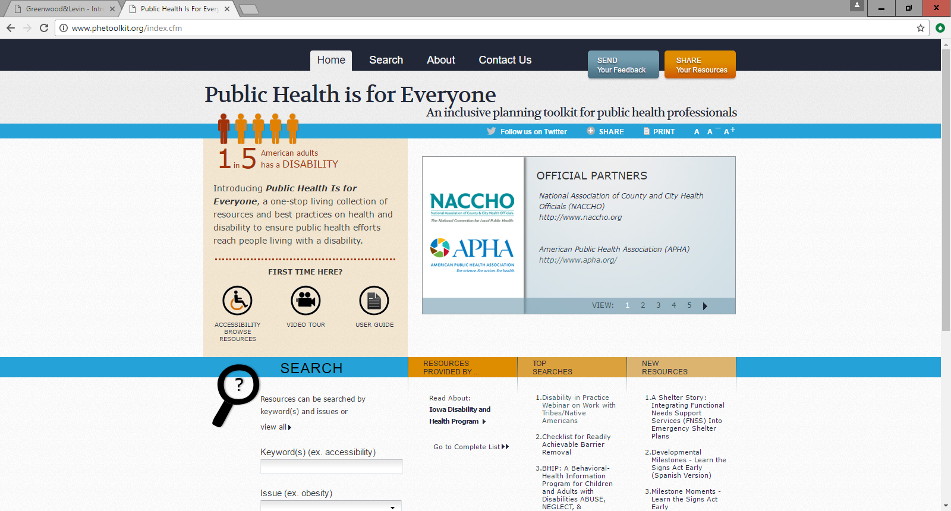
Public Health is for Everyone
Share Your Resources
Notes:
Users have the option to search using only a keyword or only an issue, or by indicating both a keyword and an issue

Slide 15
Public Health is for Everyone: www.phetoolkit.org
Nutrition
Physical Activity
Obesity
Smoking
Health Care Access
Emergency Preparedness
Accessibility
Zika
Share Your Resources!
Nutrition
Physical Activity
Obesity
Smoking Prevention & Cessation
Emergency Preparedness
Accessibility
Nutrition
Physical Activity
Obesity
Smoking Prevention & Cessation
Emergency Preparedness
Accessibility
Notes:
These are our key issues

Slide 16
Health Promotion Partner with AUCD Network
Find an AUCD Network member in your state/territory: Go to: www.aucd.org
Click on: National Information Reporting System (on left nav bar) Direct Link: http://www.aucd.org/nirs/search/search.cfm

Slide 17
Share Pair National Tools: DHDS, CDC’s 6x18 AUCD Tools: Including People with Disabilities: Public Health Workforce Competencies Public Health is for Everyone AUCD Network Directory
Notes:
Inform and inspire – new? What can you use?

Slide 18
Think about…Self-care How do you take care of yourself? How about while you are engaged in this work? What works for you to maintain wellbeing?
Adriane’s lessons learned:
-Empower all staff and leverage their networks -Develop ambassadors to sustain change -Practice self-care
Notes:
Work smarter

Slide 19
Think about… the Hats You Wear: What roles can help you in this work? What partners can help? Who do you know who already know these partners?
Notes:
Work smarter

Slide 20
Making Change Happen - Lesson from Kung Fu Panda: The secret ingredient is YOU!
Notes:
Self care in our work is essential

Slide 21
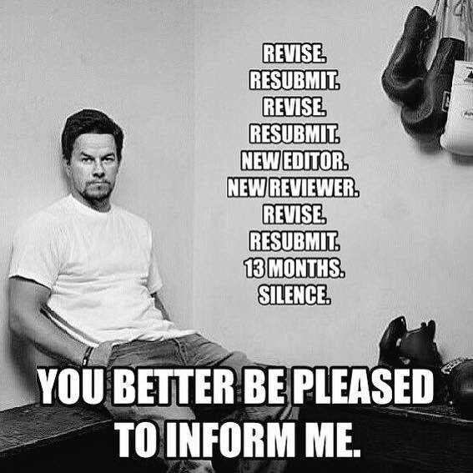

Slide 22
State Action Research - Lessons Learned Five conditions fostered readiness, capacity building, and capacity among public health partners to include PWD: 1) Facilitative leadership 2) Timing 3) Personal Interest/Commitment 4) Support 5) Systematic Reflection
Notes:
Self care in our work is essential

Slide 23
Take Home Message: Be a Public Health Ninja
Take Home Message: Public Health Ninja
A Public Health Ninja…
master of change
uses multiple strategies and tools, simultaneously
does not make announcement – just makes it happen
humble – doesn’t need personal recognition
focus on community needs

Slide 24
Thank you! Stay in touch Adriane K. Griffen, DrPH, MPH, MCHES Senior Director of Public Health and Leadership Association of University Centers on Disabilities (AUCD) 1100 Wayne Avenue, Suite 1000, Silver Spring, MD 20910 Phone: 240-821-9374 Email: agriffen@aucd.org Web: www.aucd.org
Notes:
Work smarter

